Slide 1


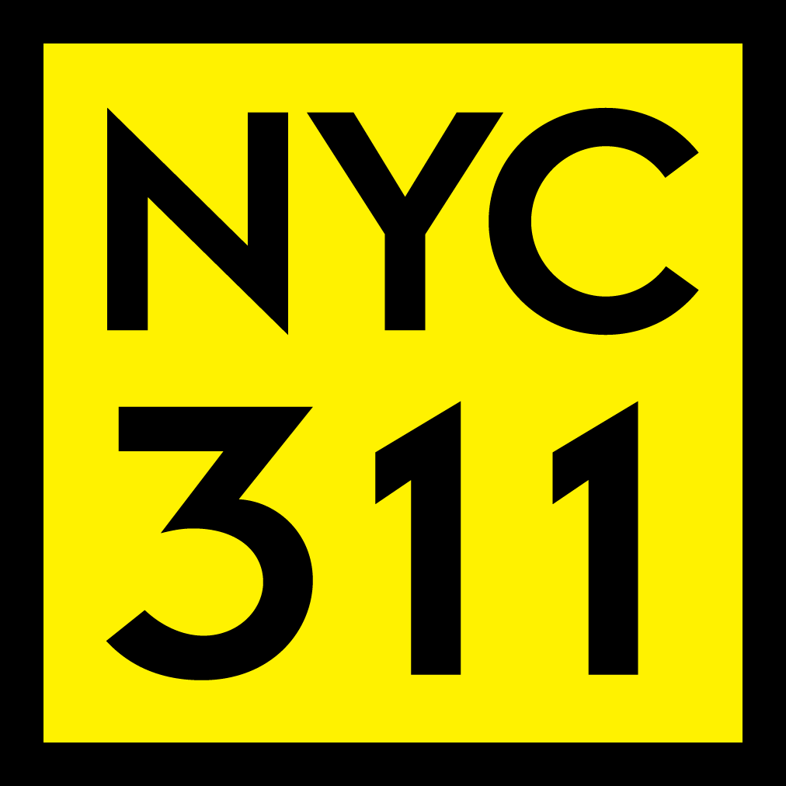
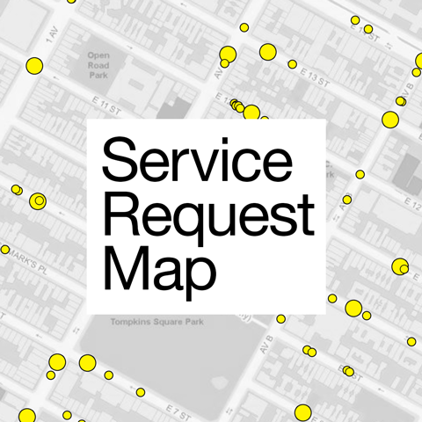

Exploring 311 Service Request Data
Using Hadoop
By: Tony Dulalia, Aylin Ignacio, Heang Chua , Sareena Grajeda, Milton Reyes
Github:https://github.com/aylinimart/aignaci7-220.116....
Notes:
Group 3 is using the NYC 311 Service Request dataset provided publicly by NYC.

Slide 2

Server Specifications:
Command: lscpu
Architecture: x86_64
CPU op-mode(s): 32-bit, 64-bit
CPU(s): 32
On-line CPU(s) list: 0-31
Thread(s) per core: 2
Core(s) per socket: 8
Socket(s): 2
NUMA node(s): 2
Vendor ID: GenuineIntel
CPU family: 6
Model name: Intel(R) Xeon(R) Silver 4110 CPU @ 2.10GHz
Stepping: 4
CPU MHz: 799.932
CPU max MHz: 3000.0000
CPU min MHz: 800.0000
BogoMIPS: 4200.00
Virtualization: VT-x
L1d cache: 32K
L1i cache: 32K
L2 cache: 1024K
L3 cache: 11264K
NUMA node0 CPU(s): 0-7,16-23
NUMA node1 CPU(s): 8-15,24-31
Server Address: aignaci7@220.116.230.21
Hadoop 3.1.1.3.1.4.0-315
DFS: 292.93GB used

Slide 3
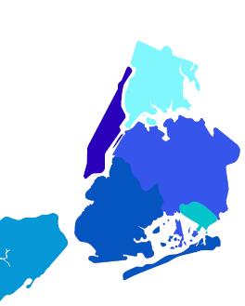
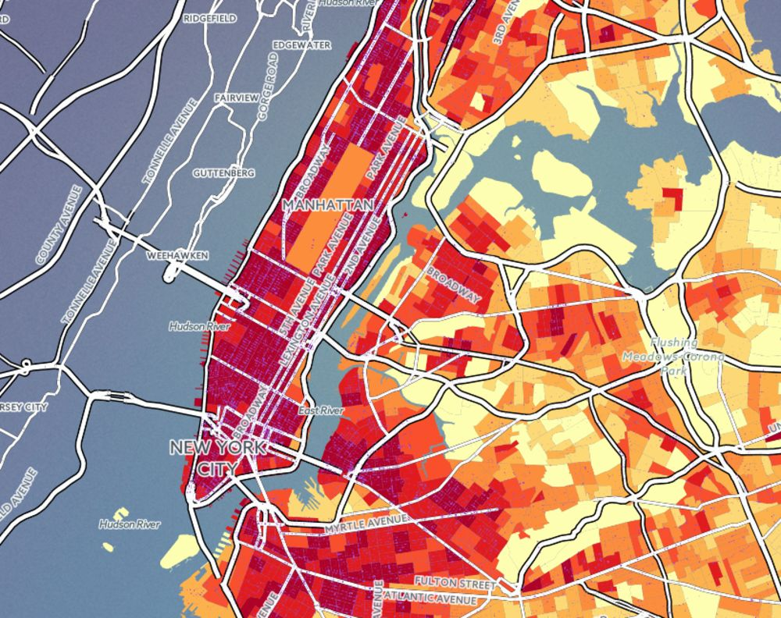

NYC OPEN DATA: 311 Service Requests from 2010 to Present ○ Sample included 24 Million requests from 2010 to Present.
1
2
311 Service Requests calls encompass all non-emergency requests from the city, including but not limited to noise complaints, air quality issues and reports of unsanitary conditions etc. The data for 311 calls in New York City (NYC) are publicly available.
Data info: NYC 311 Service Request From 2010 to P.
Data Set Size: 14.6GB
Source:https://data.cityofnewyork.us/Social-Services/311-Service-Requests-from-2010-to-Present/erm2-nwe9/data
Notes:
The 311 Service Requests calls dataset is a sample that included 24 million requests from 2010 to present time, holding data for 311 calls in New York CIty. These calls includes non-emergency requests from the city that include noise complaints, air quality issues, reports of unsanitary condition, among a long list of other requests. The dataset is updated daily, with our data pull on May 7th. NYC311 provides New Yorkers easy access to all New York City government services and information, requests can be made online, by text, phone, or social media.

Slide 4
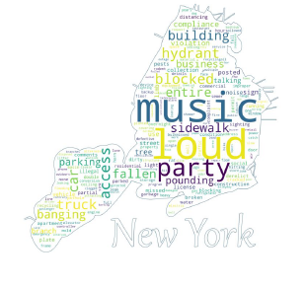
3
Words related to the following appeared most frequently:
noise
illegal parking
tree condition
sidewalk/street condition
Agencies receiving service call requests:
NYPD - New York Police Department
HPD - Housing Preservation & Development
DOT - Department of Transportation
DSNY - Department of Sanitation
DEP - Department of Environment Protection
DOB - Department of Buildings
DPR - Department of Parks & Recreation
DOHMH - Department of Health and Mental Hygiene
DOF - Department of Finance
TLC - Taxi & Limousine Commission
Notes:
With the 311 service calls, there appeared to be four prominent words that were used frequently throughout the calls. Noise, illegal parking, tree condition, and sidewalk/street conditions were the 4 main reasons these calls were coming in. The agencies receiving the majority of service call requests are those listed above.

Slide 5
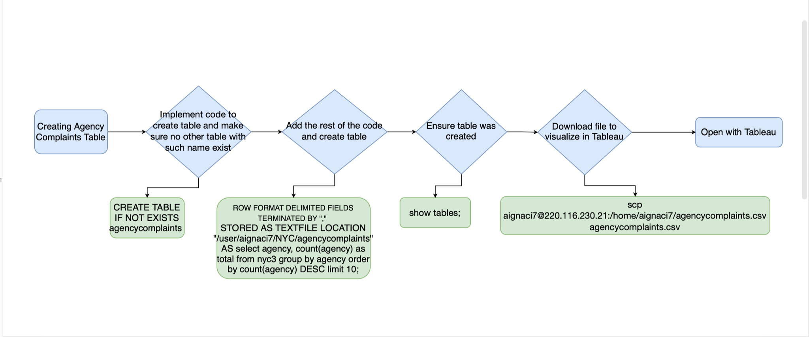
Flowchart
Notes:
The flow chart is a representation of the steps that are taken and code that is executed in order to produce a series of tables.

Slide 6
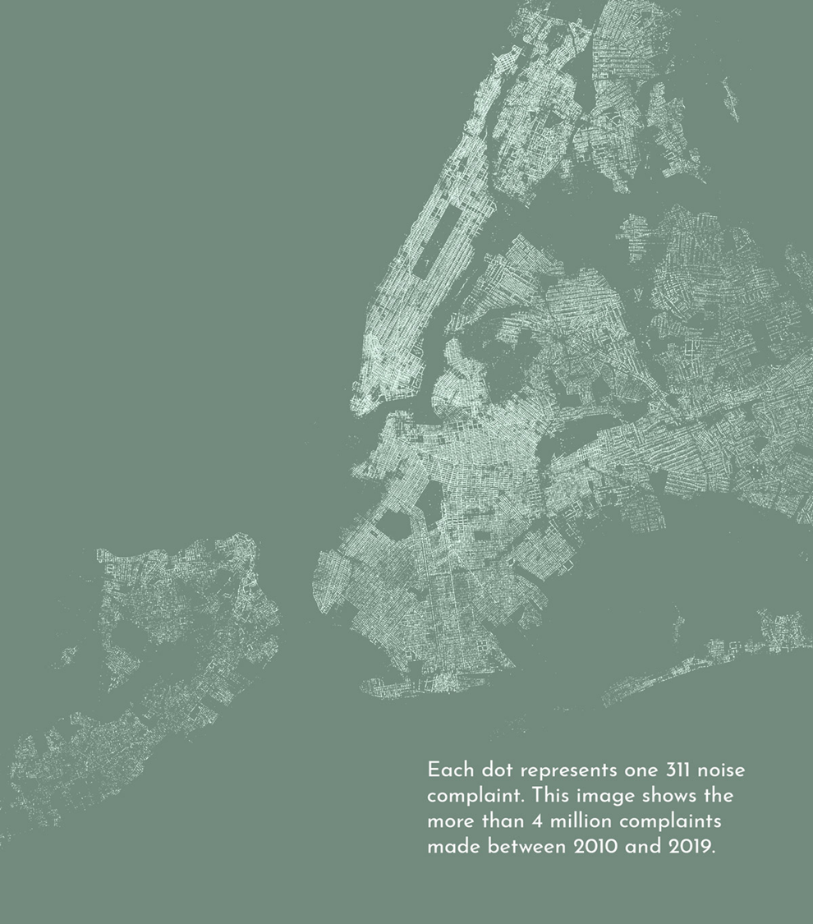
Rank Complaint Category # Complaints
1 Noise /Residential 2,326,197
2 Heat/Hot Water 1,496,220
3 Illegal Parking 1,202,034
4 Block Driveway 1,085,385
5 Street Condition 1,045,529
6 Street Light Condition 1,000,820
7 Heating 887,869
8 Plumbing 760,952
9 Noise /Street Sidewalk 715,726
10 Water System 699,113
Notes:
This chart showcases the number of calls/complaints that were made in New York City from the year of 2010 to year 2019. Ranking Noise and residential complaint as the top complaint, with over 2 million calls being taken regarding noise or residential complaints.

Slide 7
Data (Continued)
Rank Complaint Category #Complaints
10 Water System 699,113
11 General Construction/Plumbing 536,641
12 Noise 539,648
13 Unsanitary Condition 531,319
14 General Construction 500,863
15 Traffic Signal Condition 478,652
16 Noise Commercial 405,306
17 Paint/Plaster 390,232
18 Sewer 390,232
19 Damage Tree 368,462
20 Paint Plaster 361,257
Source: 311 Service Requests from 2010 to Present:
Link: https://data.cityofnewyork.us/Social-Services/311-Service-Requests-from-2010-to-Present/erm2-nwe9/data
Notes:
Continuation of the chart provided on previous slide.

Slide 8
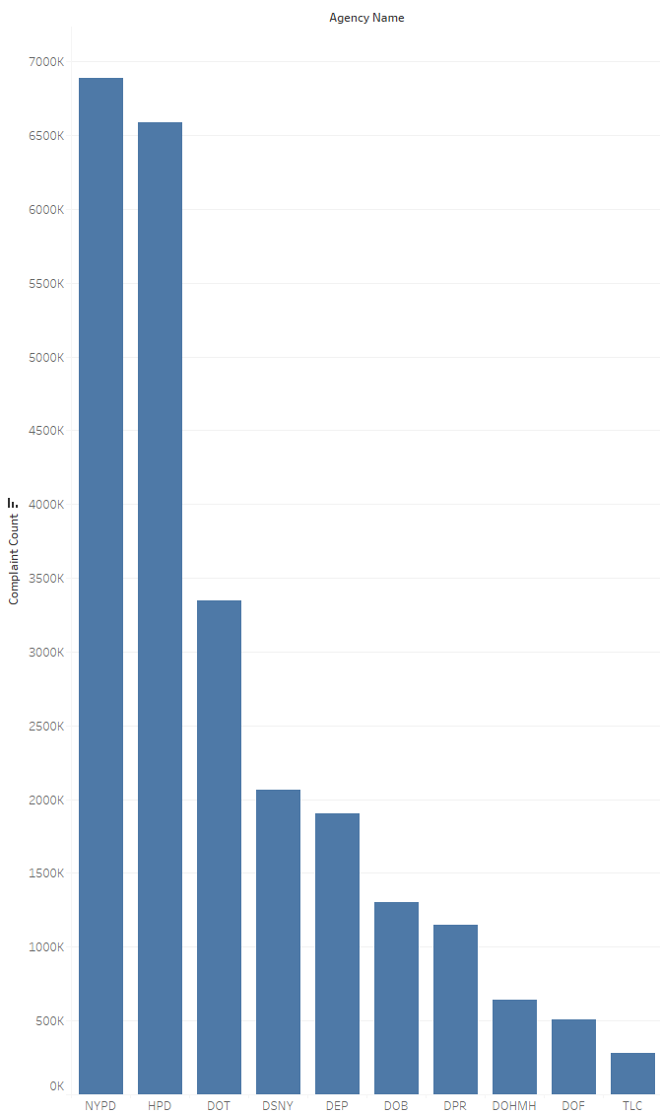
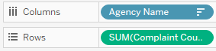
By Agency and Total Number of Complaints
NYPD 6,890,882
HPD 6,588,303
DOT 3,346,381
DSNY 2,066,475
DEP 1,902,501
DOB 1,301,871
DPR 1,146,670
DOHMH 642,563
DOF 511,033
TLC 282,525
Notes:
Tony:
After creating tables and loading the data for these created tables, we download the file to better visualize the data we’ve collected…
The following bar chart was produced on Tableau by agencies that received the 311 calls and by the total number of complaints, showing NYPD with the highest number of complaints. Complaints are received by call centers, both online and mobile and then filed to the appropriate departments. Also, in Tableau we set the fields as the Agency Name and the records as the SUM for Counts to Complaints.

Slide 9
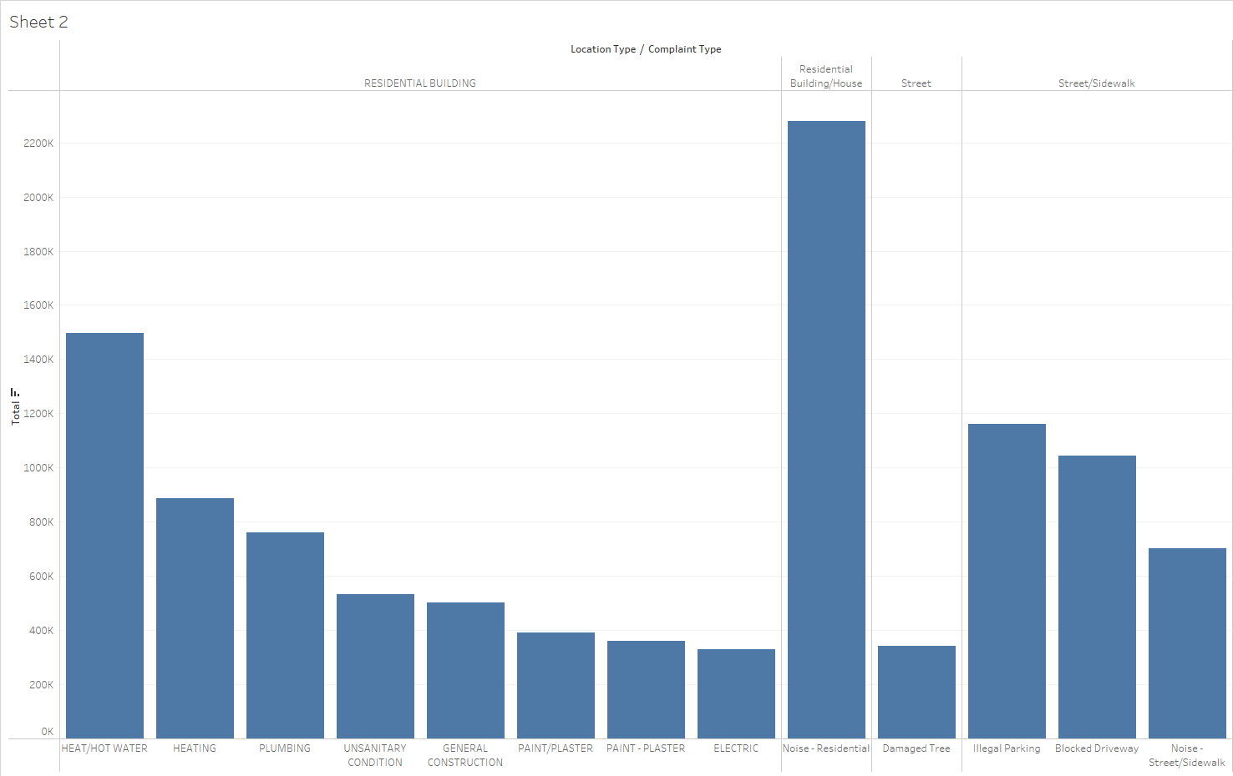
Complaint Type categorized
With Location Type
Notes:
Tony:
This chart (also done in Tableau) shows the top complaint types made to 311 based on location type. The data is categorized with complaints designated to their Location Type, so with Using this information we can see that within residential area, the highest number of complaints deals with noise and also hot water and heating. In streets, unsurprisingly it is illegal parking and blocked driveways.

Slide 10
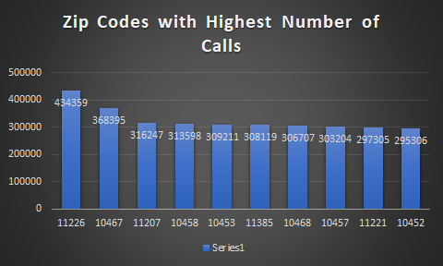
By Location (Zip Codes)
Zip Total
11226 434359 Brooklyn
10467 368395 Bronx
11207 316247 New York City
10458 313598 Bronx
10453 309211 New York City
11385 308119 Queens
10468 306707 New York City
10457 303204 Bronx
11221 297305 Brooklyn
10452 295306 Bronx
Notes:
Using the location by zipcode, this bar chart was produced show the number of calls throughout NYC. Looking at the barchart, you can visualize the cities with the most call requests, with the Brooklyn zipcode 11226 at the top.

Slide 11
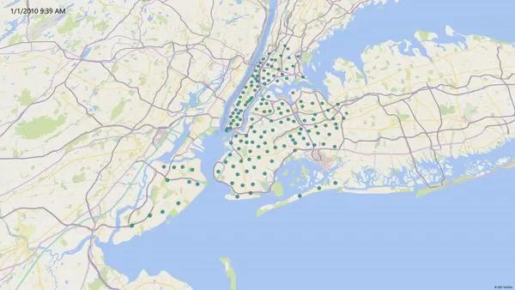
Notes:
This 3D map was created using a query selecting 5000 records in 2010 sorted by date, using this we created date and location columns, and exported for use in excel. We slowed the video down to make it easier to see changes as requests were received.

Slide 12

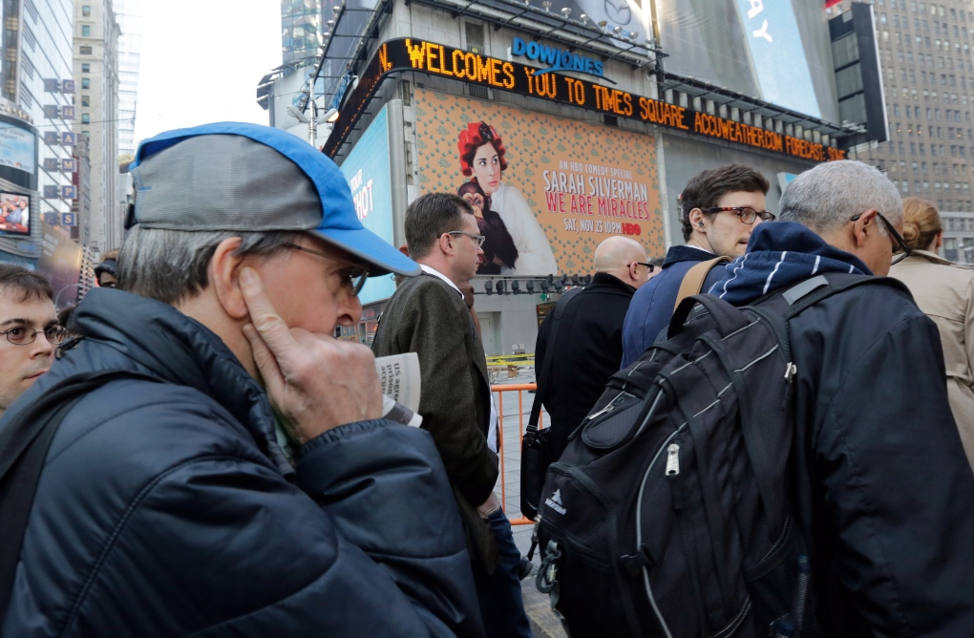
Conclusion
The description of a 311 call, after being encoded as numeric data, is a strong predictor of the agency that responded to the call. Noise complaints make up the majority of 311 calls and are assigned to the NYPD. This analysis lends itself to further inquiry into how non-emergency service requests are handled in NYC and other cities.

Slide 13
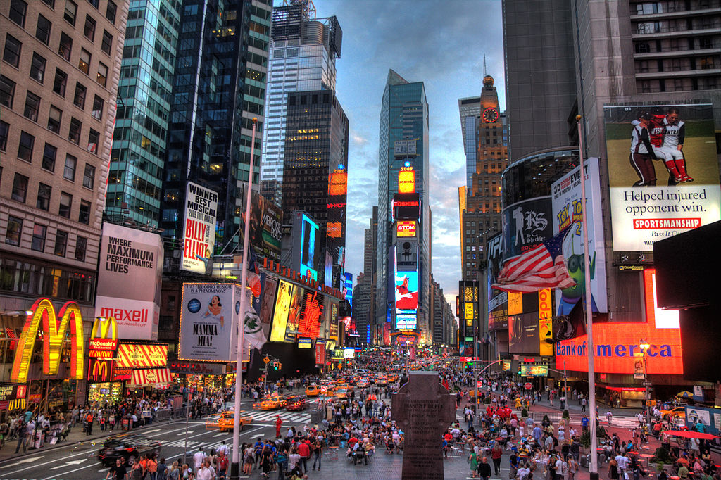
Conclusion(Continued)
If a similar classifier were trained on larger and more diverse description data, could the assignment of government agencies to non-emergency requests be handled more efficiently? In terms of meeting the needs of city residents, does it make sense for the same agency responsible for emergency calls to handle most 311 requests? Future research in the fields of data science and public policy should explore these questions further.

Slide 14
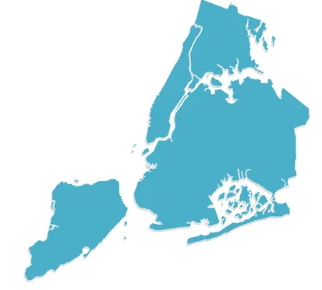
Thank you!
End of Presentation

